Slide 1

Data Cleaning 101: Preparing Data for Analysis
Presented by
Evan E. Ozmat, MS
Notes:
Good afternoon everyone, and welcome to Data Cleaning 101!
Today, we’re diving into one of the most critical yet overlooked parts of the research process: data cleaning. If you don’t already know me, my name is Evan Ozmat, I’m a 4th year doctoral student in the counseling psychology program and I spend a lot of my time cleaning data.
During this seminar I’ll be guiding you through the principles and practical steps you need to prepare your Qualtrics data in SPSS and RStudio for high-quality analysis.
Let’s get started!

Slide 2

What You’ll Learn Today
Understand the Key Principles of Data Cleaning
1
What it is and why it matters.
Learn Practical Steps to Clean Qualtrics Data in SPSS and RStudio
2
Address common issues like missing values, duplicate entries, and coding errors.
Prepare Data for Analysis
3
Ensure your dataset is ready for statistical testing, modeling, and reporting.
Notes:
By the end of today’s seminar, you’ll walk away with three main takeaways.
First, we’ll cover the key principles of data cleaning—what it involves and why it’s critical. T
hen, we’ll move into hands-on practical steps specifically for cleaning Qualtrics data in SPSS and RStudio, addressing common issues like missing values and recoding variables.
Finally, I’ll show you how to ensure your data is properly prepared for the analyses you plan to run, whether it’s a basic t-test or a more complex structural equation model.
These skills are essential for producing reliable, reproducible research.

Slide 3

Why Clean Data?
Ensures Accuracy in Results
Unclean data leads to unreliable findings.
Supports Reproducibility
Clean data allows others to verify and build on your work.
Avoids Errors in Interpretation
Inconsistent coding or missing data can skew results and invalidate conclusions.
Notes:
Before we dive into the ‘how,’ let’s talk about the ‘why.’ Data cleaning is absolutely essential for three main reasons.
First, it ensures accuracy in your results. If your dataset is full of errors, your conclusions will be, too.
Second, it supports reproducibility—a cornerstone of scientific research. A clean dataset allows others to replicate your work and ensures your findings stand the test of time.
Lastly, it helps avoid errors in interpretation. Mislabeling or inconsistent coding can drastically alter your analysis and lead to false conclusions. As psychology researchers, the integrity of our work depends on getting this step right.

Slide 4

Key Principles of Data Cleaning
Know Your Data
Understand the structure and variables before cleaning.
Document Every Step
Keep a log of changes for transparency and reproducibility.
Handle Missing Data Thoughtfully
Decide on deletion, imputation, or other strategies based on the context.
Standardize Variable Names and Codes
Ensure consistency across your dataset.
Check for Outliers
Determine whether extreme values are errors or meaningful data points.
Notes:
Data cleaning can feel overwhelming, but following these key principles will make the process manageable and effective.
First, always know your data—familiarize yourself with the structure, variables, and what each represents.
Next, document every step you take during cleaning. This not only helps you stay organized but also supports reproducibility if someone else reviews your work.
Thoughtfully handle missing data by considering the best strategy for your research context.
Standardize your variable names and codes to avoid confusion later on.
Finally, check for outliers—determine whether those extreme values are errors or important insights that require closer examination.

Slide 5

Cleaning Data for Psychological Research
Survey Data Challenges
Response scales, reverse coding, and missing survey items.
Behavioral Data
Attention checks, Implausible values, and outlier thresholds.
Demographic Variables
Ensuring proper categorization of gender, race, and other sensitive data.
Ethical Considerations
Protecting participant confidentiality during data cleaning.
Notes:
As psychology researchers, we face unique challenges when cleaning our data. Survey data often requires additional attention, such as reverse coding and handling skipped questions.
Behavioral data obtained through surveys needs rigorous checks for outliers or implausible values.
Demographic variables require careful categorization to ensure inclusivity and accuracy, especially with sensitive data like gender and race.
Lastly, ethical considerations are paramount—always protect participant confidentiality and handle data with the utmost care.

Slide 6

Cleaning Qualtrics Data
Export and Import
Export Qualtrics data and open in SPSS.
Identify & Inspect
Variables of Interest
Check variable names, types, and labels (Generate a codebook).
Examine Missingness
Identify missing data and decide on deletion, imputation, or exclusion.
Recoding
Reverse-code items and standardize response categories.
Save a Clean Copy
Always save the cleaned dataset as a separate file.
Notes:
Now, let’s get into the practical steps for cleaning Qualtrics data in SPSS. First, export your data from Qualtrics and import it into SPSS. Begin with a thorough inspection of your variables—ensure variable names, types, and labels make sense. Next, address any missing values thoughtfully, using deletion, imputation, or exclusion depending on your analysis plan. You’ll also need to recode certain items, especially reverse-coded ones. Finally, always save a clean copy of your dataset as a separate file so you have a backup if needed. We’ll dive deeper into each of these steps shortly.

Slide 7
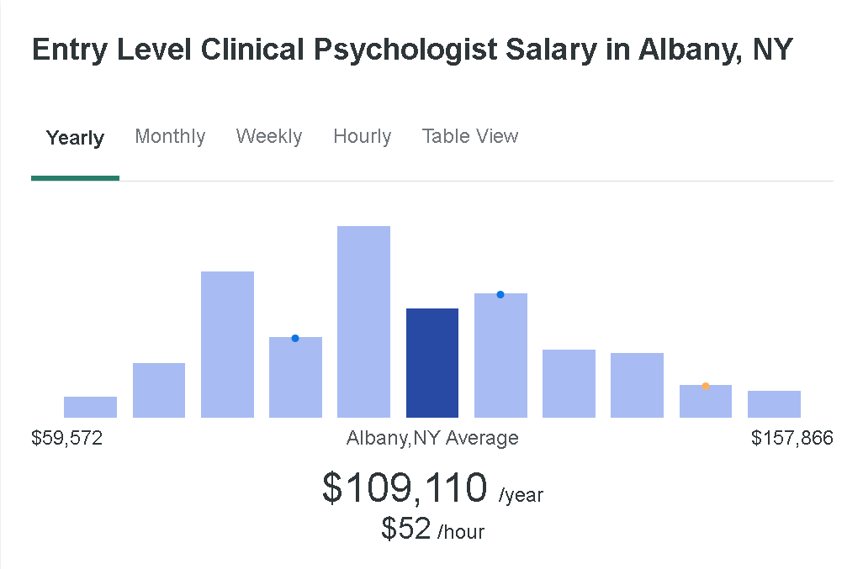

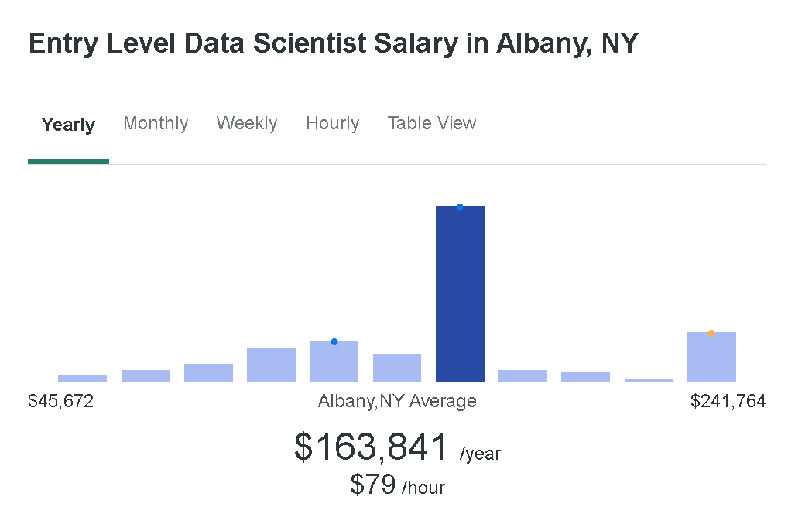
Coding: An Essential Skill for Researchers
Coding ensures:
Documentation:
Every step is recorded for transparency.
Reproducibility:
Others (and future you!) can follow your workflow.
Tools of the Trade
SPSS Syntax ($99 monthly or $1,069.2 yearly)
Automates repetitive tasks.
Saves your commands for easy reuse.
Rstudio (FREE!)
Handles more complex cleaning tasks.
Offers unmatched flexibility and scalability.
Bonus: Coding saves time in the long run!
Notes:
Let’s talk about coding. If you thought you could conduct research without it, I have some bad news for you—coding is an essential part of modern data cleaning.
But don’t worry, it’s not as scary as it sounds.
Additionally, coding fulfills two of the core principles of data cleaning: documentation and reproducibility.
With tools like SPSS Syntax, you can automate repetitive tasks and save your commands for easy reuse later. RStudio takes it a step further, offering unparalleled flexibility for handling more complex data cleaning tasks.
The best part? Coding actually saves you time in the long run. Once you’ve coded a process, you never have to start from scratch again. So, while coding might feel intimidating at first, think of it as a critical skill that will make you a more efficient and effective researcher.

Slide 8
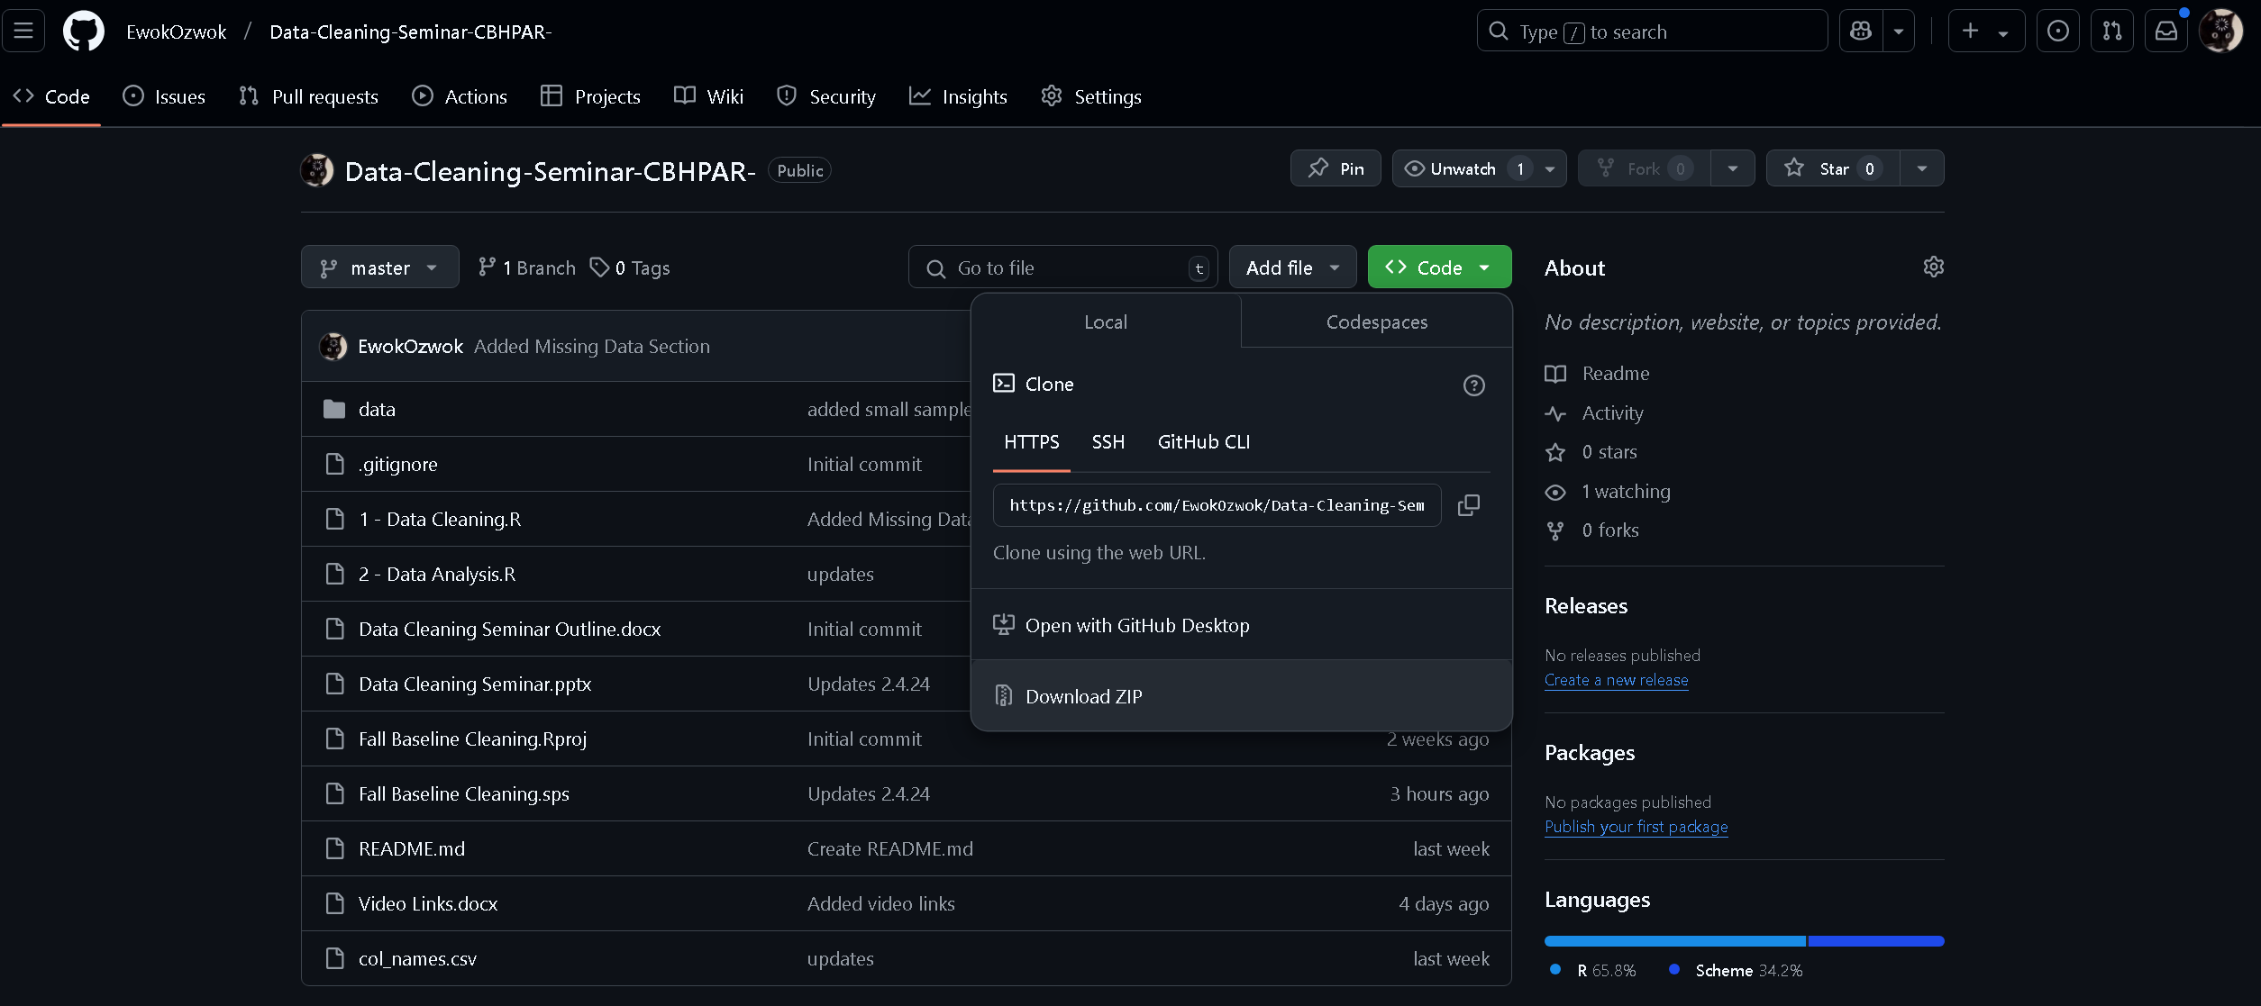
https://bit.ly/4aPv5j8

